Slide 1

Research Project
LOS Prediction Under Rainy Condition

Slide 2
Determining the quality of highway service caused by rainfall 2013
providers’ (traffic class, traffic control and safety)
road users’ (travel time, comfort, delay and queues)
Road providers’ quality of highway service input
Traffic class distribution
Determining the coordinates of speed/flow curve
Mean speed and cumulative speed distribution statistical tests
Traffic shockwave velocity propagation
Road users input in context
Travel time
Speed/flow curve coordinates

Slide 3
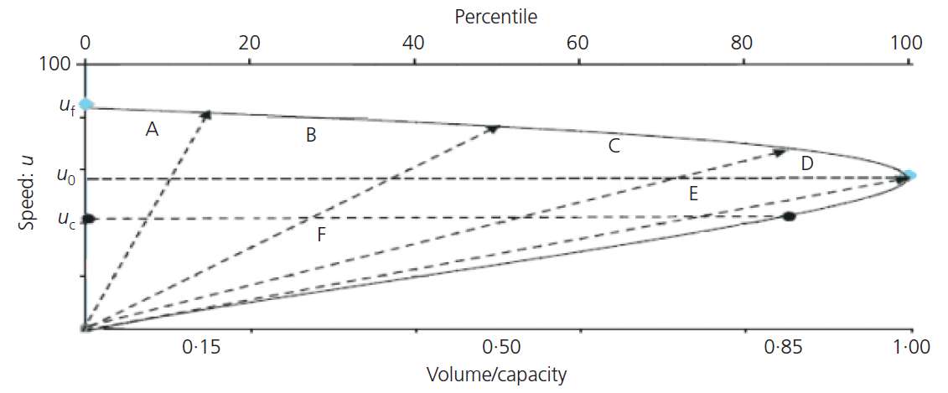
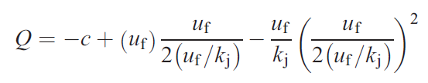
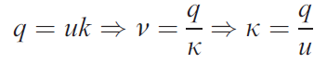
Traffic class distribution
Determining the quality of highway service caused by rainfall 2013

Slide 4
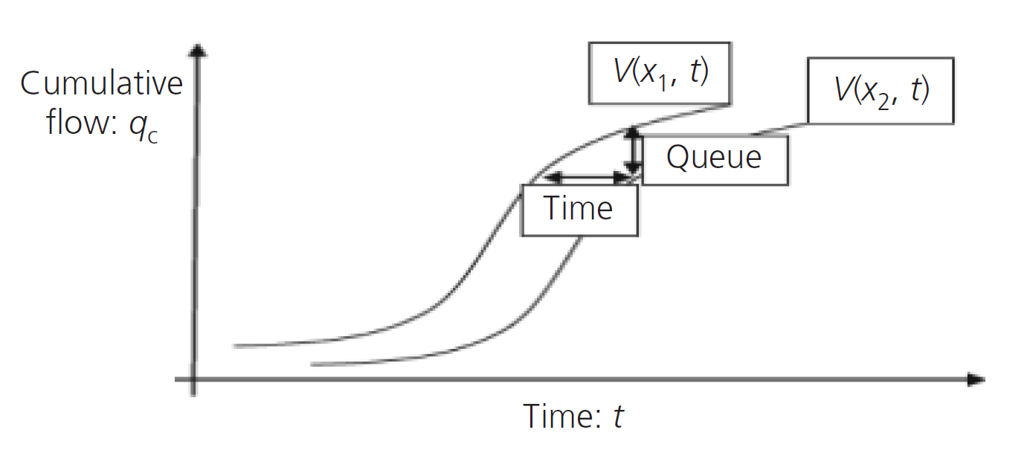
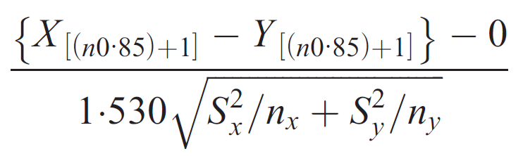
Mean speed and cumulative speed distribution statistical tests
Determining the quality of highway service caused by rainfall 2013

Slide 5
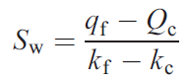
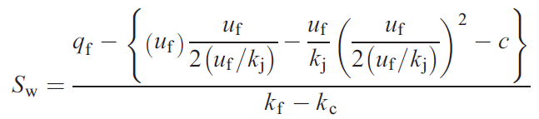
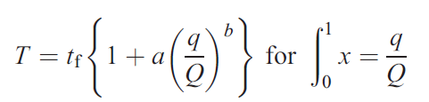
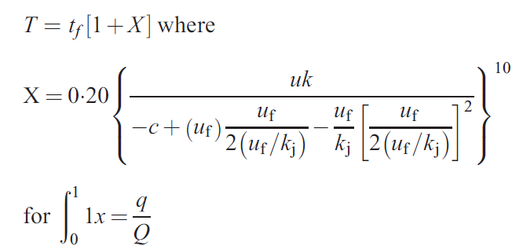
Traffic shockwave velocity propagation Road users input in context
Determining the quality of highway service caused by rainfall 2013

Slide 6
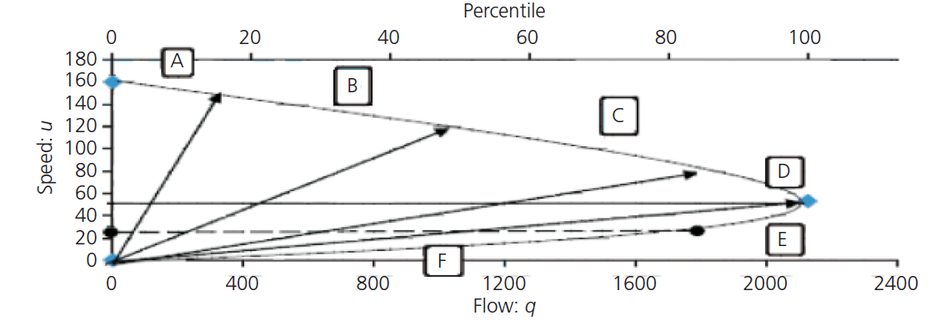
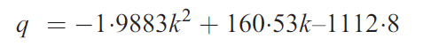
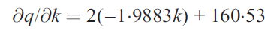
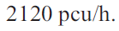
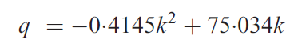
Speed/flow curve coordinates
Determining the quality of highway service caused by rainfall 2013

Slide 7
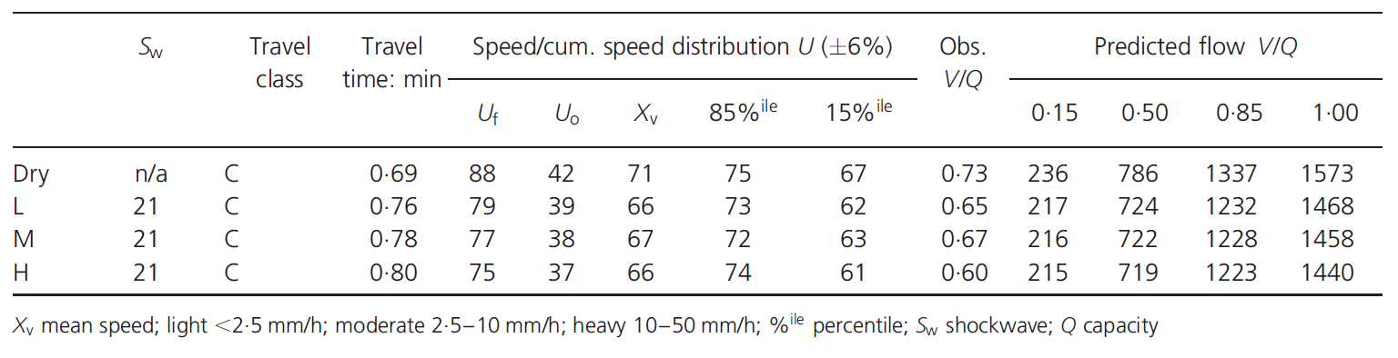
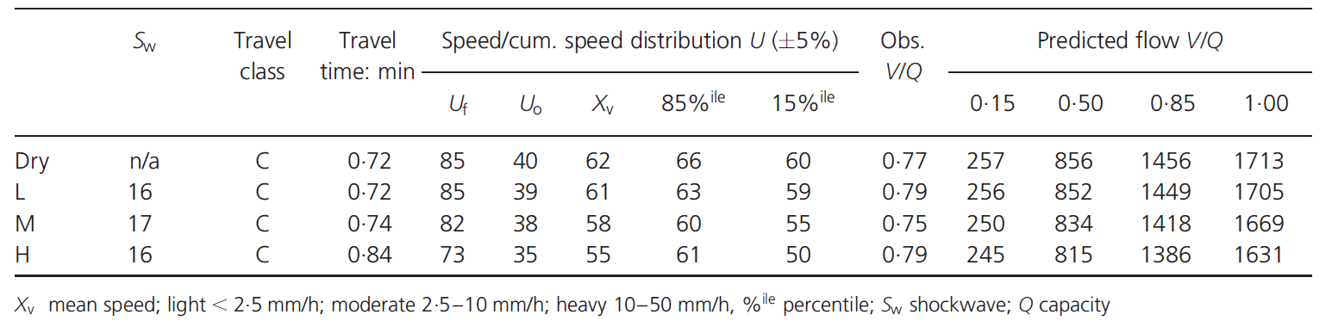
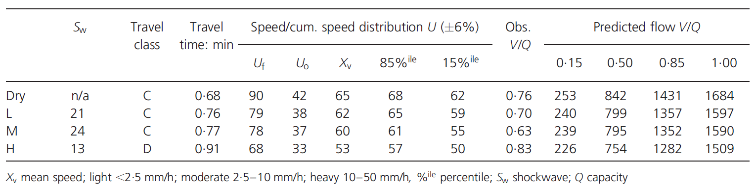
Results
Determining the quality of highway service caused by rainfall 2013

Slide 8
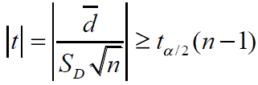
T - Test
Assessing the Impact of Rainfall on Traffic Operation of Urban Road Network 2013
Notes:
Let Dn = Xn – Yn, and d , Sn^2 represent the sample mean and the observed value of the sample variance.

Slide 9
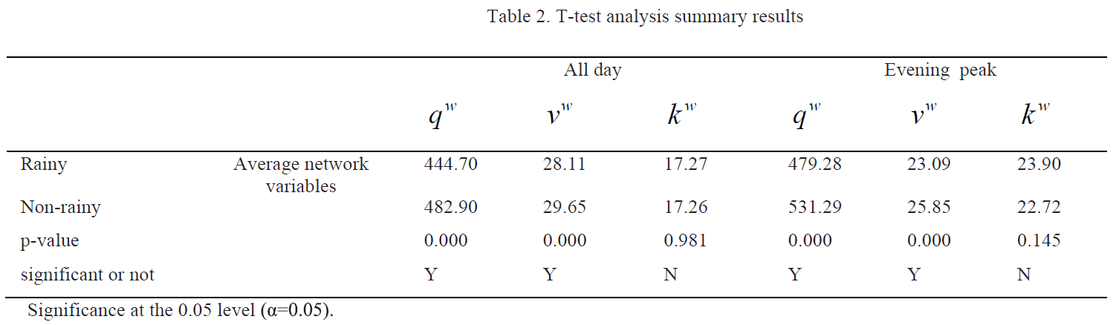
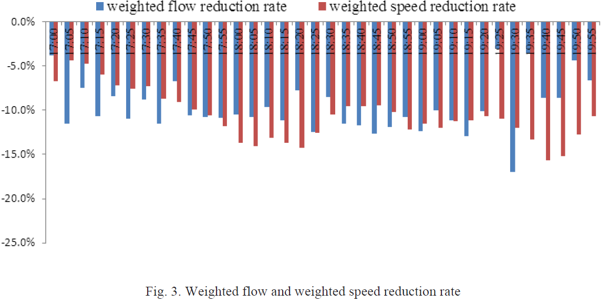
Results
Assessing the Impact of Rainfall on Traffic Operation of Urban Road Network 2013

Slide 10
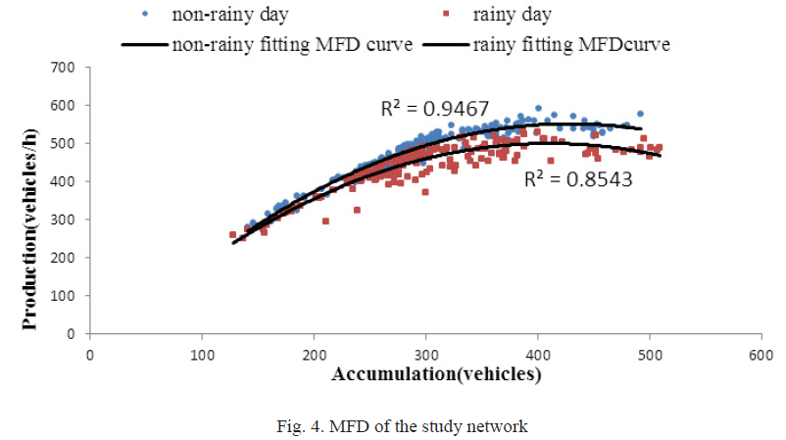
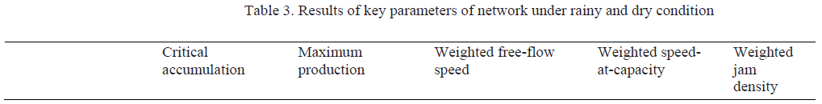
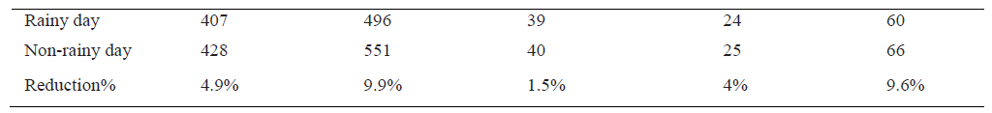
MFD Results
Assessing the Impact of Rainfall on Traffic Operation of Urban Road Network 2013

Slide 11
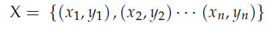
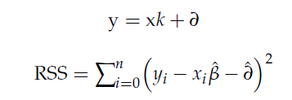
Vulnerability index
Impact of Rainfall on Traffic Speed in Major Cities of China - 2021
Notes:
Hypothesis testing was performed on the results of the regression analysis. A value of
p < 0.05 was considered statistically significant.
In this vulnerability evaluation index, the slope of the regression coefficient represents
the degree of influence of the rainfall intensity on the urban traffic congestion index, i.e.,
the traffic vulnerability index.

Slide 12
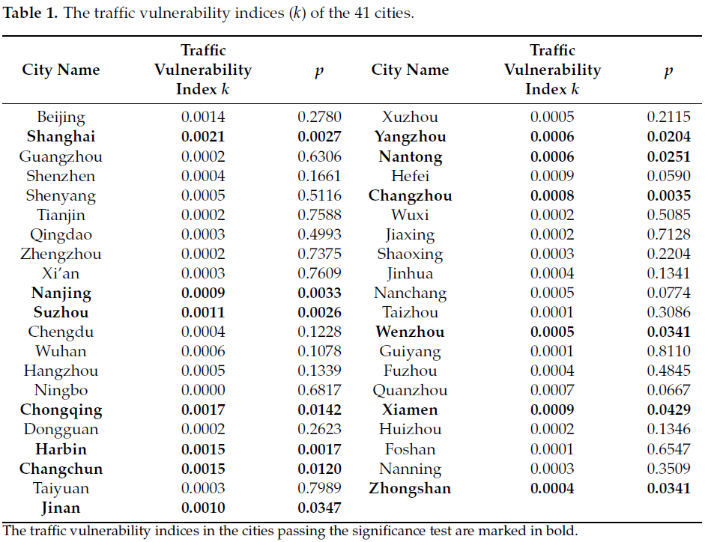
Vulnerability index
Impact of Rainfall on Traffic Speed in Major Cities of China - 2021

Slide 13
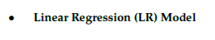
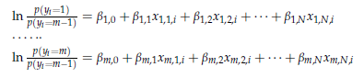
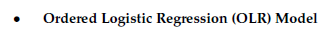
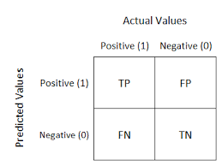

LSTM Model
Exploring the Spatial-Temporal Relationship between Rainfall and Traffic Flow A Case Study of Brisbane, Australia 2020
Notes:
Sensitivity = TP / (TP + FN)
Specificity = TN / (TN + FP)
Positive Predictive Value (PPV) = TP / (TP + FP)
Negative Predictive Value (NPV) = TN / (TN + FN)
Accuracy = (TP + TN) / (TP + TN + FP + FN)

Slide 14
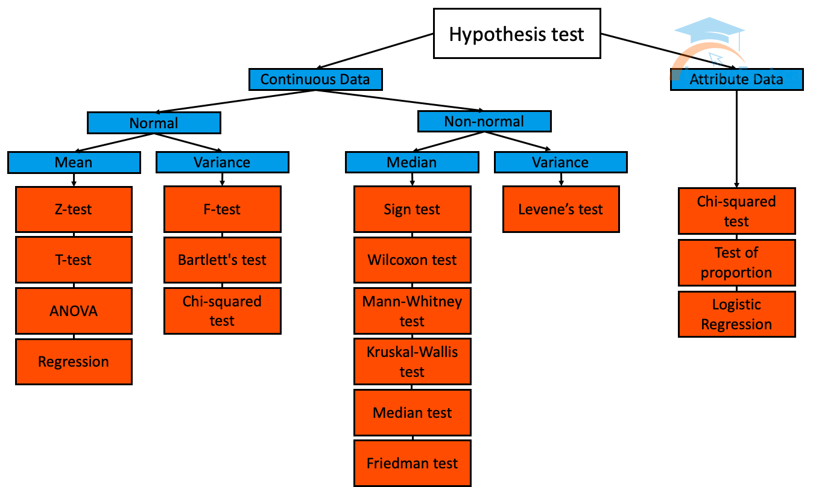
Correlation Methods
Impact of Rainfall Intensity on Macroscopic Traffic Variables of Urban Roads Using Data from Bluetooth Detectors 2021
Hypothesis_Tests:
Correlation Tests: This section lists statistical tests that you can use to check if two samples are related.
Parametric Statistical Hypothesis Tests: This section lists statistical tests that you can use to compare data samples.
Nonparametric Statistical Hypothesis Tests: Tests whether the distributions of two independent samples are equal or not.
Notes:
Correlation Tests: Example: Let's say you want to test if there is a correlation between rainfall and the number of umbrellas sold in a city. You collect data for different days, recording the amount of rainfall (in millimeters) and the corresponding number of umbrellas sold. You can then use a correlation test, such as the Pearson correlation test, to determine if there is a significant correlation between rainfall and umbrella sales.
Parametric Statistical Hypothesis Tests:
Example: Suppose you are comparing the mean heights of two different populations, A and B. You collect height measurements from random samples of individuals from each population. To determine if there is a significant difference in the mean heights between the two populations, you can perform a t-test, such as an independent samples t-test or a paired samples t-test, depending on the nature of your data.
Nonparametric Statistical Hypothesis Tests:
Example: Let's say you want to compare the median commute times between two cities, X and Y. You collect data on commute times from random samples of individuals in each city. Since the data may not follow a normal distribution, you can use the Mann-Whitney U test, a nonparametric test, to determine if there is a significant difference in the median commute times between the two cities.

Slide 15
Macroscopic Fundamental Diagram (MFD)
Impact of Rainfall Intensity on Macroscopic Traffic Variables of Urban Roads Using Data from Bluetooth Detectors 2021
The Flow-Speed MFD can be mathematically represented by the formula: Q = h(V)
Q is the flow rate (number of vehicles per unit of time)
V is the speed (distance traveled per unit of time)
h() is a function that describes the relationship between flow and speed
The functional form of the function h(V) for the Flow-Speed MFD often exhibits a power-law relationship, which can be represented as: Q = αV^β
Where:
α and β are parameters that determine the shape of the MFD curve.
Notes:
5
In this equation, the exponent β represents the sensitivity of flow rate to changes in speed. A value of β less than 1 indicates sub-linear growth, where flow rate increases at a decreasing rate as speed increases. A value of β equal to 1 represents linear growth, where flow rate increases proportionally with speed. A value of β greater than 1 indicates super-linear growth, where flow rate increases at an accelerating rate as speed increases.
Based on these factors, the shape of the MFD can take different forms:
Linear: In some cases, the MFD may exhibit a linear relationship, where the flow rate increases linearly with density up to the point of maximum flow rate (capacity), and then starts to decrease as density continues to rise due to congestion.
Concave: A concave-shaped MFD indicates a gradual increase in flow rate with density at low densities, reaching a maximum at the capacity point, and then decreasing more rapidly as congestion intensifies.
Convex: A convex-shaped MFD indicates a slower increase in flow rate with density at low densities, reaching a maximum at the capacity point, and then decreasing more gradually as congestion builds up.
S-shaped: An S-shaped MFD represents a combination of concave and convex curves, where the flow rate increases slowly at low densities, reaches a maximum at capacity, and then decreases moderately before declining more rapidly at high densities.
In this equation, the exponent β represents the sensitivity of flow rate to changes in speed. A value of β less than 1 indicates sub-linear growth, where flow rate increases at a decreasing rate as speed increases. A value of β equal to 1 represents linear growth, where flow rate increases proportionally with speed. A value of β greater than 1 indicates super-linear growth, where flow rate increases at an accelerating rate as speed increases.

Slide 16
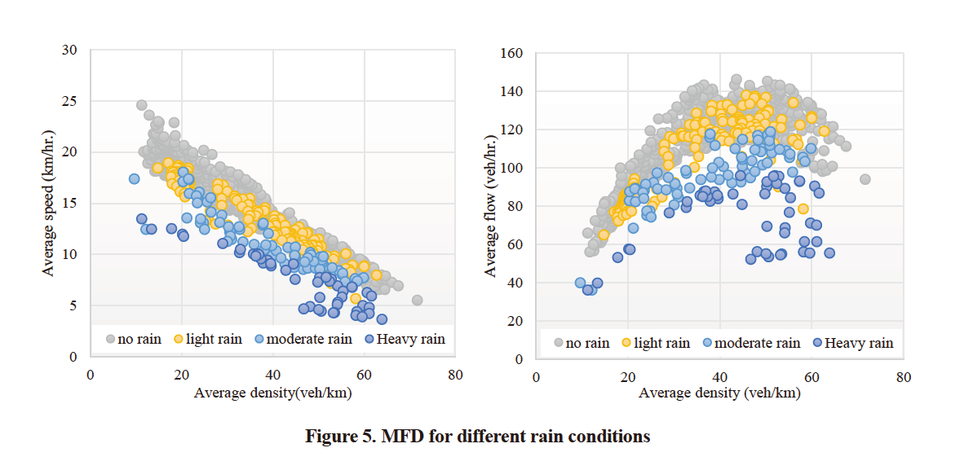
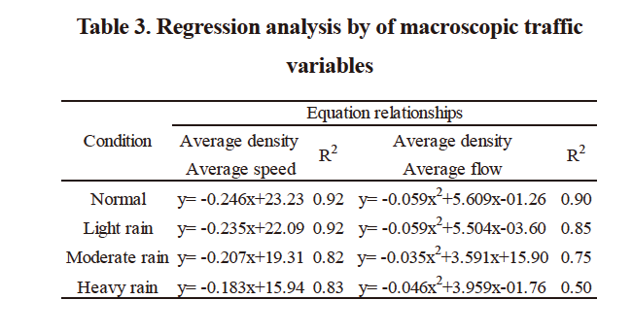
Impact of Rainfall Intensity on Macroscopic Traffic Variables of Urban Roads Using Data from Bluetooth Detectors 2021
Macroscopic Fundamental Diagram (MFD)
Notes:
1

Slide 17
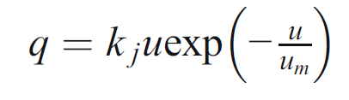
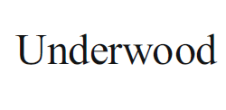
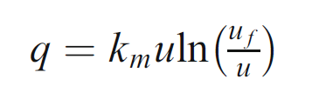
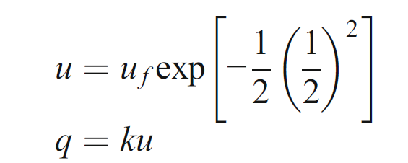
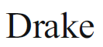
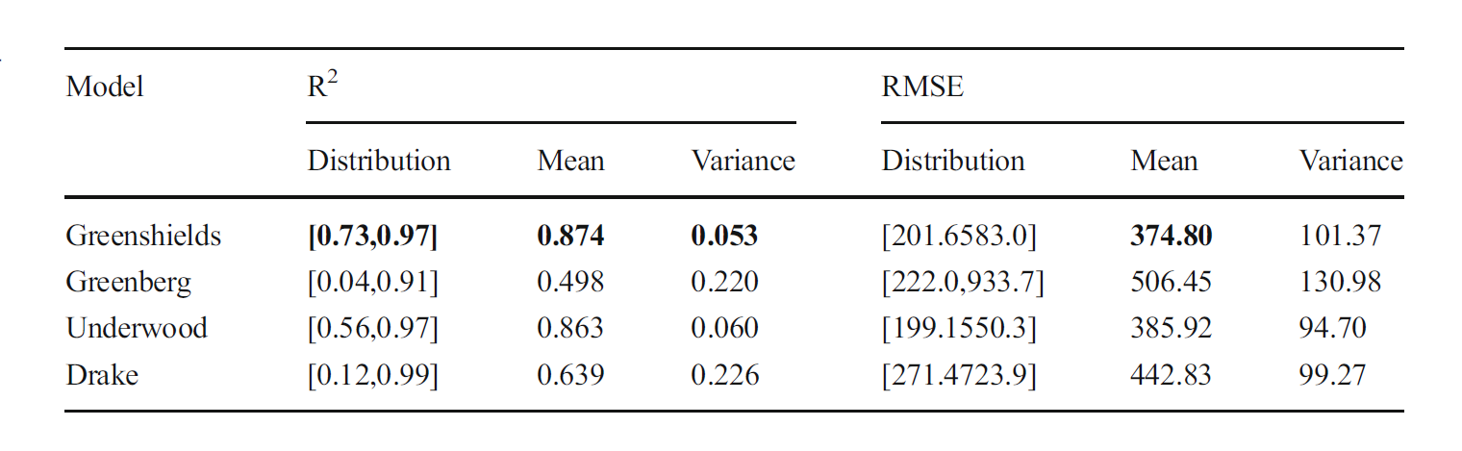
Impact Analysis of Rainfall on Traffic Flow Characteristics in Beijing 2018
Greenberg
Notes:
2

Slide 18
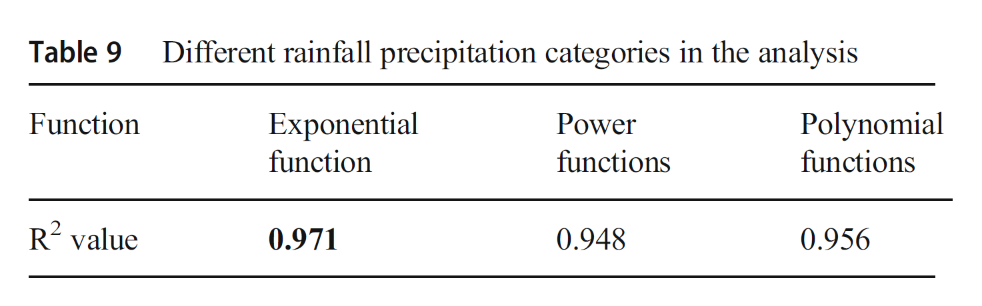
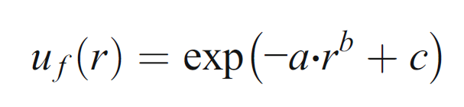
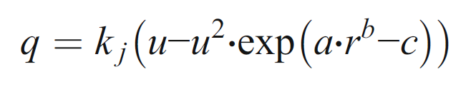
Impact Analysis of Rainfall on Traffic Flow Characteristics in Beijing 2018
Notes:
3
where uf(r) is the free-flow speed which is a polynomial function of the rainfall intensity;
the dependent variable r is the rainfall intensity; and a, b, and c are three parameters for calibration.
where kj is the jam density of the traffic flow, u is the space mean speed -> SMS = Total Distance / Total Time
of the traffic flow, and q is the traffic flow.
exponential functions, power functions, and
polynomial functions.

Slide 19
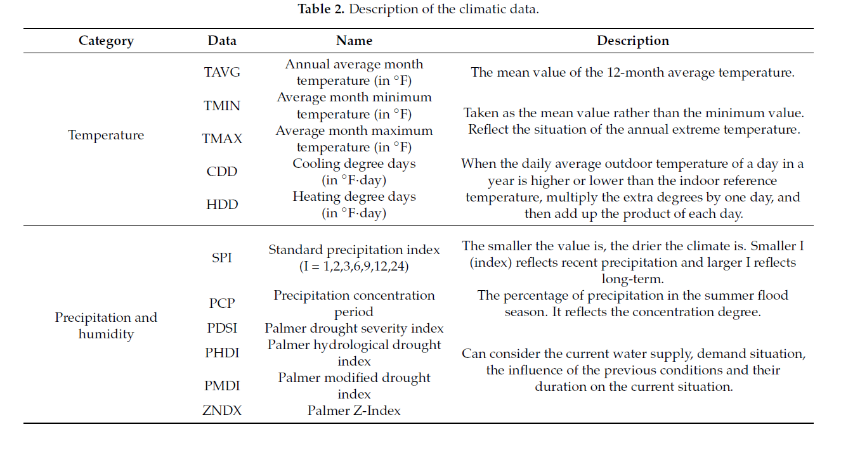
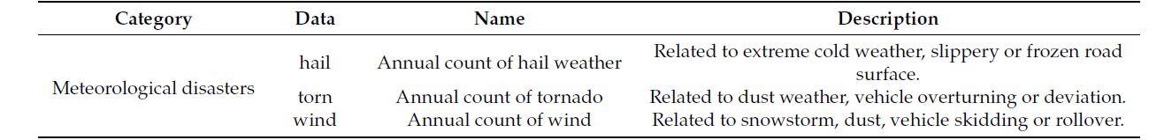
Exploring the Impact of Climate and Extreme Weather on Fatal Traffic Accidents 2021
Notes:
3

Slide 20
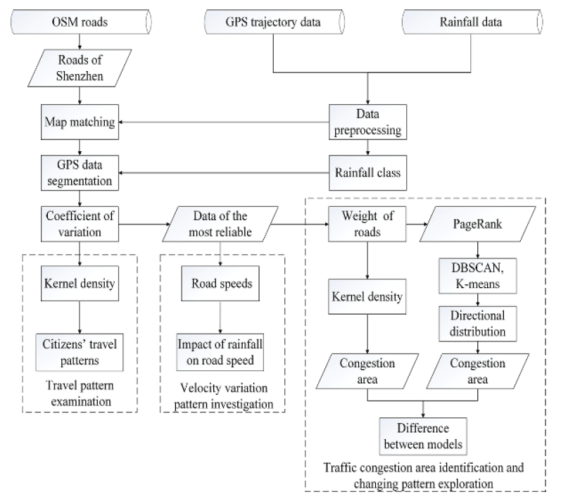
Analyzing the Effects of Rainfall on Urban traffic congestion Bottlenecks 2020

Slide 21
Multimodal Deep Learning
Transfer Learning
Graph Neural Networks
Ensembling and Fusion
Feature Engineering and Traditional Machine Learning
Notes:
15
In this approach, you can combine the rainfall data and street data using data fusion techniques. This involves preprocessing the data, extracting relevant features, and then training a deep learning model on the fused data. The model can be designed to take both rainfall and street-related features as inputs and predict the corresponding change in LOS. You can use techniques like convolutional neural networks (CNNs) for processing spatial street data and recurrent neural networks (RNNs) for handling sequential rainfall data.
If you have street data that can be represented as a graph, such as a road network, you can employ Graph Neural Networks (GNNs) for prediction. GNNs are designed to handle graph-structured data and can capture the relationships between different street segments or road nodes. By incorporating rainfall data as node or edge features in the graph representation, you can train a GNN to predict the change in LOS based on the combined information.
Ensembling techniques, such as model averaging or stacking, can be used to combine predictions from multiple models. In this approach, you can train separate deep learning models on rainfall data and street data individually. Then, you can combine the predictions from these models using fusion techniques, such as weighted averaging or majority voting, to obtain the final prediction of the change in LOS. This can help leverage the strengths of each model and enhance prediction accuracy.
If you have additional domain knowledge about the relationship between rainfall and LOS, you can incorporate handcrafted features derived from the rainfall and street data. These features may capture specific characteristics or interactions that are relevant to the problem. Once the features are engineered, you can apply traditional machine learning algorithms, such as random forests or support vector machines, to build a predictive model.

Slide 22
Study | Traffic Data | Weather | Prediction Method | Findings
Assessing the Impact of Rainfall on Traffic Operation of Urban Road Network 2013 | Guangzhou | - | Hyposesis Test and Regression | 4.9% reduction in critical accumulation 9.9% reduction in max flow
Determining the quality of highway service caused by rainfall 2013 | Malayisa | Light: <2.5mm/h Moderate: 2.5-10mm/h Heavy: 10-50mm/h | F-observed T-observed | Capacity loss Speed reduction Shockwave no obvious correlation
Improving Traffic Flow Prediction with Weather Information in Connected Cars A Deep Learning Approach 2016 | PEMS dataset (47 freeways) (http://pems.dot.ca.gov/), 15 min resolution | NOAA, 1 h sampling interval Rainfall data from 16 stations available hourly, resampled to 15 min | ARIMA, ANN and DBN | -

Slide 23
Study | Traffic Data | Weather | Prediction Method | Findings
Impact Analysis of Rainfall on Traffic Flow Characteristics in Beijing 2018 | Beijing | - | Mathematic methods and callibrating | -
Exploring the Spatial-Temporal Relationship between Rainfall and Traffic Flow A Case Study of Brisbane, Australia 2020 | Australia | Temperature Rainfall Wind speed | LR, MLR, OLR | precipitation affects an increase in traffic demand | weather conditions have a greater impact in urban areas compared with suburban areas.
Impact of Rainfall on Traffic Speed in Major Cities of China 2021 | Major Cities of China | - | Ordinary Least Squares (OLS) Regression Analysis | Existenceof relationship

Slide 24
Study | Traffic Data | Weather | Prediction Method | Findings
Analyzing the Effects of Rainfall on Urban traffic congestion Bottlenecks 2020 | China | Stations | ICC | -
Estimating the Impact of High-Fidelity Rainfall Data on Traffic Conditions and Traffic Prediction 2021 | - | high-resolution rainfall radar images of street networks | RNN | -
Exploring the Impact of Climate and Extreme Weather on Fatal Traffic Accidents 2021 | - | - | Negative Binomial model and the log-change model | precipitation increases by 0.5 mm in 24 months, the number of fatal traffic accidents will increase by 4.8% in California and 4.6% in Arizona .
Impact of Rainfall Intensity on Macroscopic Traffic Variables of Urban Roads Using Data from Bluetooth Detectors 2021 | vehicle detectors placed on the main roads of Bangkok | light(0.1-10mm/h) | moderate(10.1-35mm/h) | heavy(over 35mm/h) | Hyposesis Test and Regression | average speed reduction -> 6.7% to 53.3% | average traffic flow rate reduction -> 1% to 27% | increase in travel time -> 4.5% to 128%

